Slide 1
CSE-06 WT Assignment
S.No: 63
Name: Nikhil Gupta
Roll No.: 20051523
Section: CSE 06

Slide 2
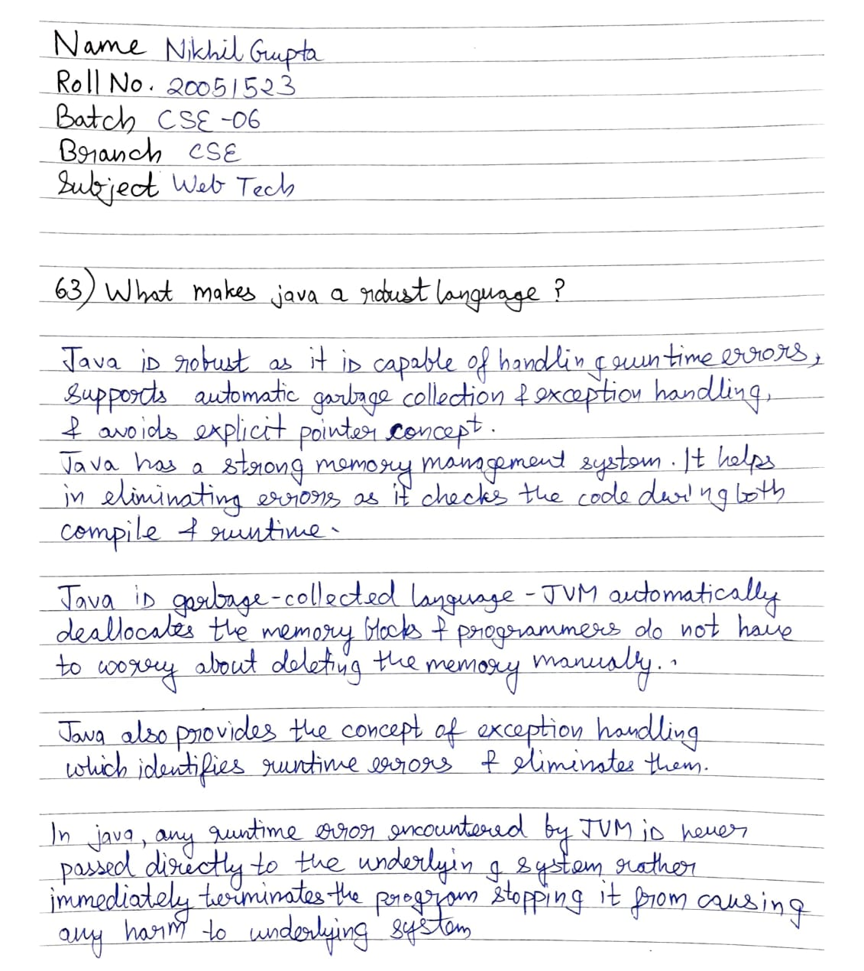
EXERCISE

